Slide 1

DETECTION AND MITIGATION OF NDP ATTACK FOR AMI DEVICES IN SMART GRID
Presented by :
Purbasha Chowdhury
Sona Shaw
Premansu Kar
Guided under :
Dr.Nabendu Chaki

Slide 2

In The Presentation
Introduction
India’s Electricity needs
What and why Smart Grid
Comparison
Smart Meter
AMI
IPV6 in Smart Grid System
Attack Scenario
Proposed Mitigation
Conclusion
2 of
25

Slide 3
Introduction
India’s current Electricity Distribution scheme
Electric Power and Power Transmission
Present one-way Electric Transmission System
New idea to do more with less
Requirement of more devices
Environment and Technology
Reliable and Automated
Security and Threats
3 of
25

Slide 4
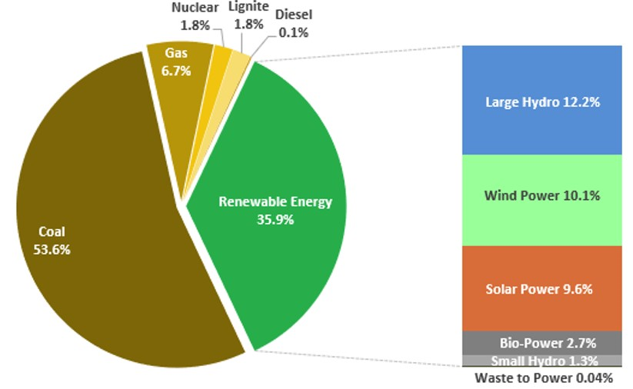
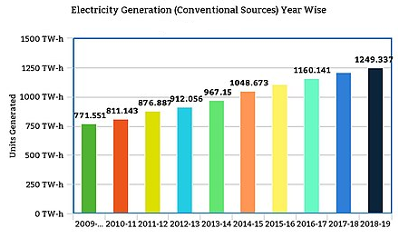
India’s Electrical Needs
Our Team Style
Electricity Generated
(installed power capacity as on 31 Dec 2019)
Source: Mercom India Reasearch / powermin.nic.in
4 of
25

Slide 5

Why Smart Grid?
Improve distribution management
Self-sufficient & self-healing too
Automation technology
Sensing & measurement technologies
Increased efficiency
Sustainable & quality electricity
Dynamic pricing mechanism
Web portal & mobile apps
WHAT IS SMART GRID?
• It is an electric grid that uses information and communication technology to gather data and act on information about the behaviour ofsuppliersand consumers in an automated fashion.
• Smart Grid is a generic label for the application of computer, intelligence and networking abilities to the existing dumb electricity distribution systems.
5 of
25

Slide 6

Comparison
Conventional Grid
Smart Grid
Electromechanical
Digital
One way transmission
Two way transmission
Centralized Organization
Distributed Organisation
Manual Monitoring
Self Monitoring
Not Reliable
Reliable
6 of
25

Slide 7

Smart Meter
Our Team Style
Risks
Communicates via wireless network. So, possibility of hacking is high.
Once connected to the AMI which provides an access point for hackers. From there, hackers can adjust bills and take payment information.
The communication can be established via spoofed IP-MAC paired message came from an attacker to the genuine one.
What is Smart Meter
Provides advanced functionalities of remote meter reading for collecting smart meter data
Two way technology that can help to increase the reliability
Recognizes and details electric consumption
Power outrage notification & power quality monitoring
Charges times of each day
Smart Meter
7 of
25

Slide 8
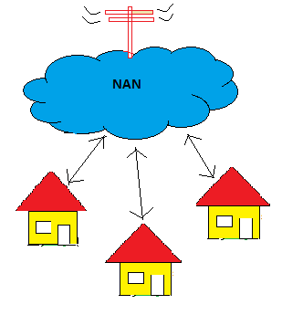
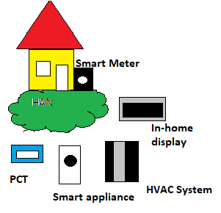
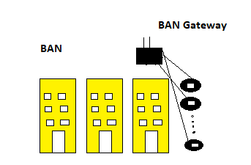
Classification of Smart Meter Network
Our Team Style
Advance Meter Infrastructure
Wide Area Network (WAN)
Neighborhood Area Network (NAN)
Building Area Network (BAN)
Home Area Network (HAN)
8 of
25

Slide 9
Need of IPV6 in Smart Grid System
1.
Compatible with the size of Smart Grid Network.
IPv4
2.
IPv6
It can be configured manually
Fragmentation
IPSec is optional
Header includes a checksum
Large address space.
Doesn’t require manual configuration
Without fragmentation
IPSec is mendatory
Header doesn’t include a checksum
3.
Auto configuration of addresses.
4.
Efficient routing.
5.
Support prioritization of messages
9 of
25

Slide 10

ICMPv6 attacks
ICMPv6 attacks
ICMP sweep
Inverse Mapping
ICMP Route Redirect
ICMP Route Discovery Message attack
Unique ICMPv6 attacks
Man In The Middle attack (MITM)
Duplicate Address Detection (DAD)
Neighbor Discovery Protocol (NDP)
10 of
25

Slide 11
ICMPv6 NDP Protocol
Our Team Style
NDP uses five ICMPv6 messages
1
Router Solicitation (RS) message
Router Advertisement (RA) message
2
Neighbor Solicitation (NS) message
3
Neighbor Advertisement (NA) message
4
Router Redirect (RR) message
5
11 of
25

Slide 12
Smart Meter Communication
Our Team Style
Smart meter – Smart meter connection
Smart meter – DCU connection with RR
Smart meter – DCU (Data Collection Unit) connection
DCU B
RA
NA
RR
RS
RA
NS
SM A
RS
SM B
IP(B)-MAC(B)
IP(B)-MAC(B)
IP(B)-MAC(B)
IP(B)-MAC(B)
IP(A)-MAC(A)
IP(A)-MAC(A)
IP(A)-MAC(A)
Connection Established
12 of
25

Slide 13
Attack Scenarios
1. Spoofed RS message : Adversary SM wants to make connection with legitimate DCU.
SM A
RS
DCU D
IP(A)-MAC(A)
Spoofed RS
RA
IP(A)-MAC(B)
IP(D)-MAC(D)
SM B
Spoof it
Connection Established between B and D
13 of
25

Slide 14
Attack Scenarios
2. Spoofed RA message : Adversary DCU wants to make connection with legitimate SM.
DCU D
RA
Spoofed RA
IP(D)-MAC(D)
SM A
RS
IP(D)-MAC(B)
DCU B
IP(A)-MAC(A)
Connection Established between A and B
Spoof it
14 of
25

Slide 15
Attack Scenarios
3. Spoofed NS message : Adversary SM wants to make connection with legitimate SM.
SM A
NS
IP(A)-MAC(A)
Spoofed NS
NA
SM D
IP(A)-MAC(B)
IP(D)-MAC(D)
SM B
Spoof it
Connection Established between B and D
15 of
25

Slide 16
Attack Scenarios
4. Spoofed NA message : Adversary SM wants to make connection with legitimate SM.
NA
SM D
Spoofed NA
IP(D)-MAC(D)
SM A
NS
IP(D)-MAC(B)
IP(A)-MAC(A)
Connection Established between A and B
SM B
Spoof it
16 of
25

Slide 17
Attack Scenarios
5. Spoofed RR message : Adversary DCU wants to make connection with legitimate SM.
DCU E
Connected
DCU D
RR
Spoofed RR
IP(D)-MAC(D)
SM A
RS
IP(D)-MAC(B)
DCU B
IP(A)-MAC(A)
RA
Spoof it
IP(B)-MAC(B)
Connection Established between A and B
17 of
25

Slide 18
Mitigation 1
Spoofed RS
DCU D
DCU C
SM B
SM A
Spoof it
Extract SM’s address B=A
The flow of messages is as packet format. Every packet has an unique IP address. Every corresponding neighbor has to keep track of the records to get rid of the spoofed attacks. Hence, there should be a cache of every neighbors in neighborhood.
Spoofed RS
RS
EchoReply = A
Echo Message
IP(A)-MAC(A)
IP(A)-MAC(B)
Check the majority decision of its neighbors.
Address didn’t matched and discard B’s RS
18 of
25

Slide 19
Mitigation 1
Spoofed RA
DCU B
DCU A
SM D
SM C
Spoof it
Extract SM’s address B=A
RS
Spoofed RA
RA
EchoReply = A
Echo Message
IP(C)-MAC(C)
IP(A)-MAC(A)
IP(A)-MAC(B)
Check its own DCU address with its neighbor’s DCU address.
Address didn’t matched and discard B’s RA
19 of
25

Slide 20
Mitigation 1
Spoofed NS
SM D
SM C
SM B
SM A
Spoof it
NS
Extract SM’s address B=A
IP(A)-MAC(A)
Spoofed NS
NS
EchoReply = A
Echo Message
IP(A)-MAC(A)
IP(A)-MAC(B)
Check the majority decision of its neighbors.
Address didn’t matched and discard B’s RS
20 of
25

Slide 21
Mitigation 1
Spoofed NA
SM D
SM C
SM B
SM A
NA
NS
Spoof it
Extract SM’s address D=C
IP(D)-MAC(D)
IP(A)-MAC(A)
NA
Spoofed NA
NS
Echo Message
EchoReply = D
IP(D)-MAC(D)
IP(D)-MAC(C)
IP(B)-MAC(B)
Check the majority decision of its neighbors.
Address didn’t matched and discard C’s NA
21 of
25

Slide 22
Mitigation 1
Spoofed RR
DCU E
DCU B
DCU A
SM D
SM C
RR
Spoof it
Connected
IP(A)-MAC(A)
Spoofed RR
RR
EchoReply = A
Echo Message
IP(A)-MAC(B)
IP(A)-MAC(A)
discard B’s RR
22 of
25

Slide 23
Mitigation 2
Mitigation for RR:
Mitigation for NS:
Mitigation for RS:
Mitigation for NA:
Mitigation for RA:
Our proposed scheme ensures the genuineness of the IP-MAC pairing by an active verification mechanism. The scheme sends verification messages termed as NS/RS probe requests upon receiving RSs, NSs, RAs, NAs and RRs. Data tables for the proposed system are:
Router Solicitation Table(RST)
Router Advertisement Table(RAT)
Neighbor Solicitation Table(NST)
Neighbor Advertisement table (NAT)
Router Redirect Table(RRT)
Probe table (PRB)
Authenticated bindings table (AUTH)
Log table (LOG)
Unsolicited advertisement table (USAT)
RR request is added to the Router Redirect Table (RRT).
RR packet is searched in Authenticate Binding Table (AUTH).
If (match) then status = GENUINE [IP-MAC pair is already recorded in AUTH table]
If (mismatch) then status = SPOOFED and spoofed packet details is recorded in LOG table.
If neither of the above cases occurred then the PROBE packet is sent to verify the genuineness of the packet.
NS request is added to the Neighbor Solicitation Table (NST).
NS packet is searched in Authenticate Binding Table (AUTH).
If (match) then status = GENUINE [IP-MAC pair is already recorded in AUTH table]
If (mismatch) then status = SPOOFED and spoofed packet details is recorded in LOG table.
If neither of the above cases occurred then the PROBE packet is sent to verify the genuineness of the packet.
RS request is added to the Router Solicitation Table (RST).
RS packet is searched in Authenticate Binding Table (AUTH).
If (match) then status = GENUINE [IP-MAC pair is already recorded in AUTH table]
If (mismatch) then status = SPOOFED and spoofed packet details is recorded in LOG table.
If neither of the above cases occurred then the PROBE packet is sent to verify the genuineness of the packet.
1. Add NAPIPS, NAPMACS, NAPIPD and tau to the Advertisement table (NAT).
2. If ((NAPIPS = NSPIPD for some NSP present in the NST table) and (NAPIPS is found in AUTH table) and (NAPMACS also matched))
Then
Status = GENUINE
3. Otherwise status = SPOOFED and spoofed packet detail is recorded in LOG table.
4. If the advertisement packet entry is not available in any Authenticated table, then a NS probe is sent to verify genuineness.
Add RAPIPS, RAPMACS, RAPIPD and tau to the Advertisement table (RAT).
If ((RAPIPS = RSPIPD for some RSP present in the RST table) and (RAPIPS is found in AUTH table) and
(RAPMACS also matched))
Then
Status = GENUINE
3. Otherwise status = SPOOFED and spoofed packet detail is recorded in LOG table.
4. If the advertisement packet entry is not available in any Authenticated table, then a RS probe is sent to verify genuineness
We use the following short notations:
𝐼𝑃𝑆 - Source IP Address
𝐼𝑃𝐷 – Destination IP Address
𝑀𝐴𝐶𝑆 - Source MAC Address
𝑀𝐴𝐶𝐷 – Destination MAC Address
Fields of any table would be represented by ⟨𝑇𝑎𝑏𝑙𝑒𝑁𝑎𝑚𝑒⟩⟨𝑓𝑖𝑒𝑙𝑑⟩
⟨𝑇𝑎𝑏𝑙𝑒𝑁𝑎𝑚𝑒⟩𝑀𝐴𝑋 represents the maximum elements in the table at a given time
23 of
25

Slide 24
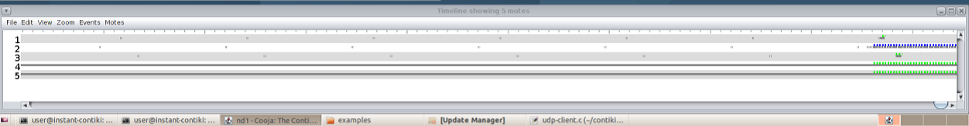
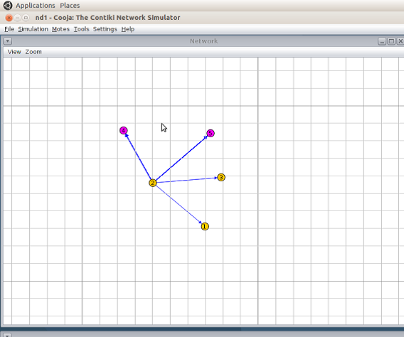
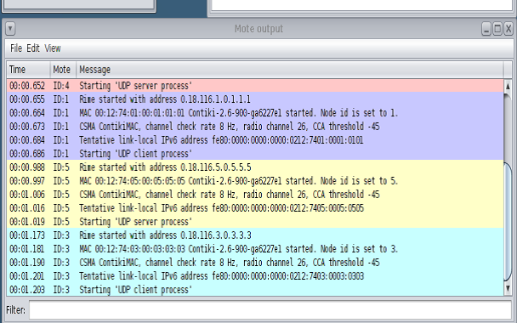
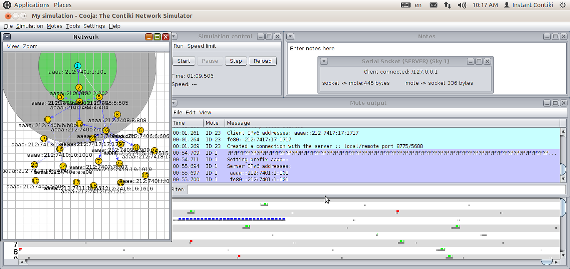
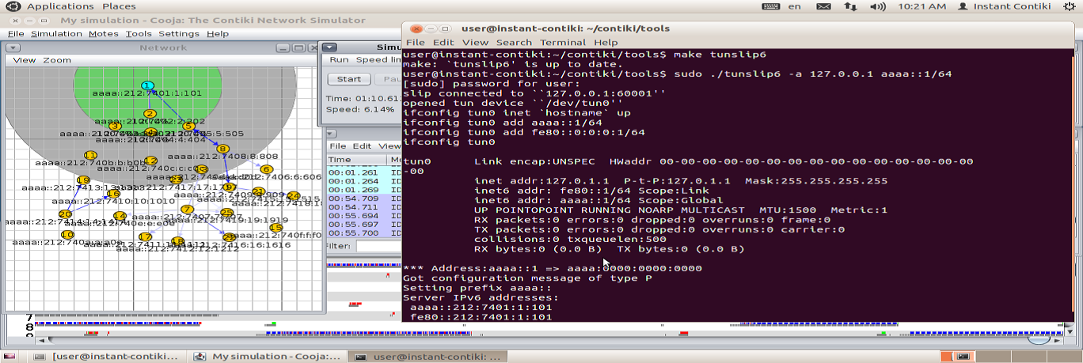
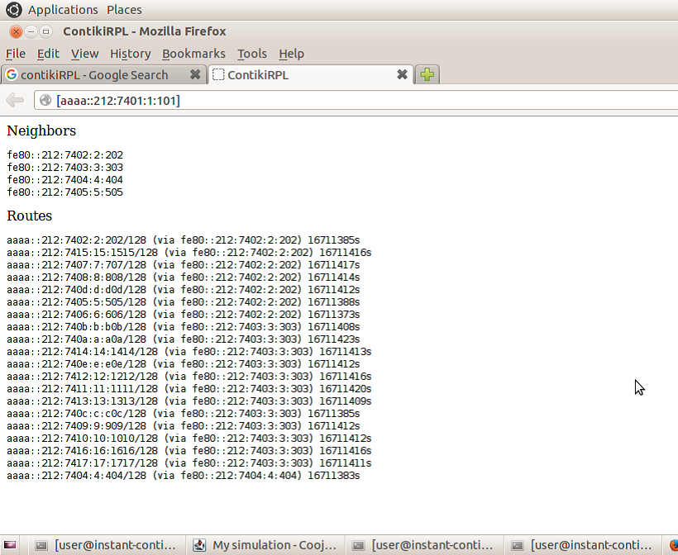
Simulation
Simulation of Step 1
Trial Network
Our Approach:
Step 1: Create a NDP network between udp-server mote and udp-client mote and implement proposed attack scenario.
Step 2: Create a NDP network between udp-server mote and udp-client mote and implement proposed mitigation algorithm.
Step 3: Comparative study between step 1 and step 2.
Timeline Output
Network creation between border-router and udp-sender motes
Radio traffic between motes
Terminal Window Output
Mote Output
Routing Table
24 of
25

Slide 25

Conclusion
Smart grid technology utilizes the electricity maximum.
Smart grid reduces unnecessary wastages of electricity.
Smart grid helps to save the earth from global warming.
Here we proposed the respective attack scenarios based upon the five
NDP messages with respect to Smart Grid Environment and also the idea of the mitigation scheme of those attacks.
In the end of this presentation, we created the connection between server & client in perspective to smart meter communication in the simulation phase.
THANK YOU
25 of
25

